Slide 1
GUI application in Python

Slide 2
steps involved in creating a GUI application in Python
The following are the general steps involved in basic GUI programs:
1. First of all, we should create the root window. The root window is the top-level window that provides rectangular space on the screen where we can display text colors, images, components, etc.
2. In the root window, we have to allocate space for our use. This is done by creating a canvas or frame: So, canvas and frame are child windows in the root window.
3. Generally, we use canvas for displaying drawings like lines, arcs, circles, shapes, etc We use frame for the purpose of displaying components like push buttons, check buttons, menus, etc. These components are also called ‘widgets’.
4. When the user clicks on a widget like push button, we have to handle that event. It means we have to respond to the events by performing the desired tasks.

Slide 3
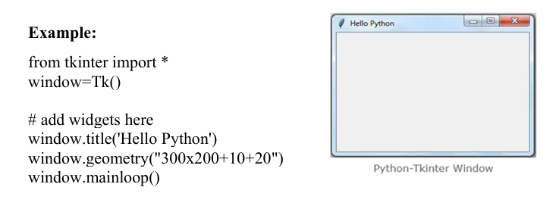

Slide 4
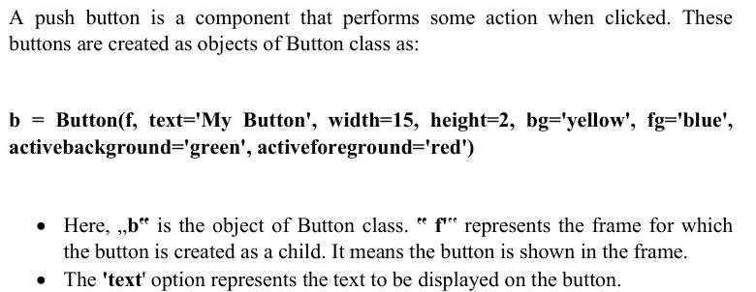
create a button widget and bind it to the event handler

Slide 5
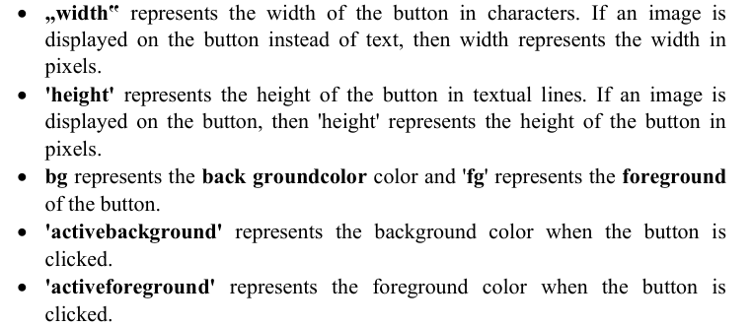

Slide 6
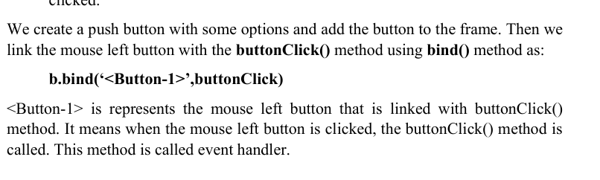

Slide 7
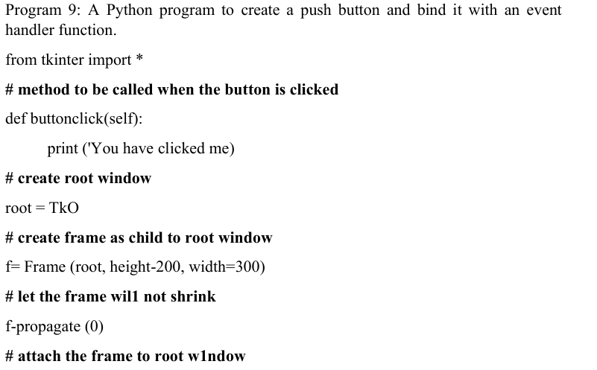

Slide 8
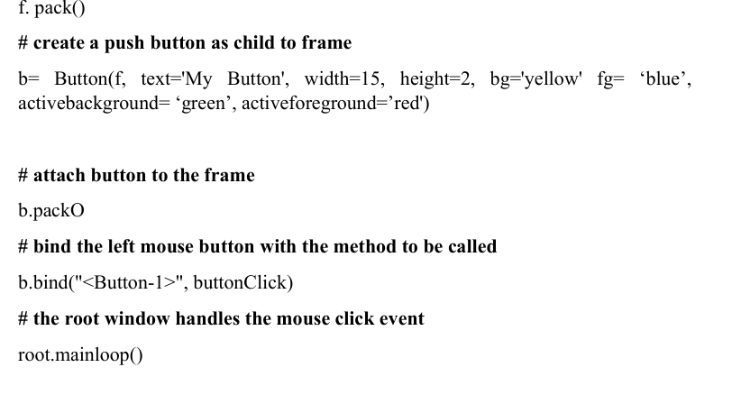
# attach the frame to root w1ndow

Slide 9
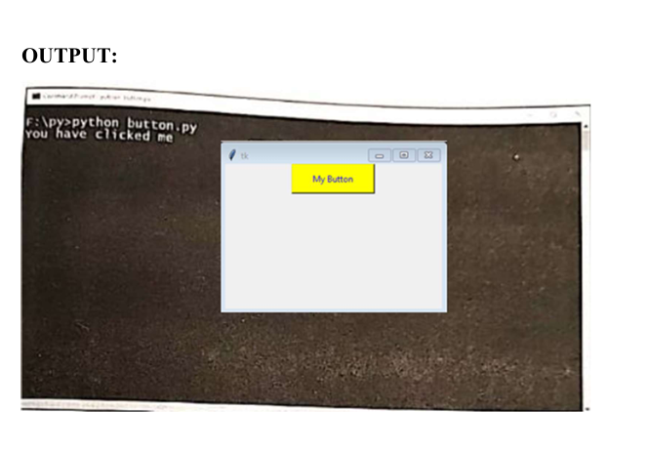

Slide 10
arranging Widgets in a frame using layout managers.
Arranging Widgets in the Frame Once we create widgets or components, we can arrange them in the frame in a particular manner. Arranging the widgets in the frame is called layout management.
There are three types of layout managers
Pack layout manager
Grid Layout manager
Place layout manager

Slide 11
Pack layout manager
Pack layout manager uses Pack() method. This method is useful to associate a widget with its parent component While using the pack() method, we can mention the position of the widget using ‘fill’ or ‘side’ options
b.pack(fill=x)
b.pack(fill=x)
The ‘fill’ option can take the values: X, Y, BOTH, NONE. The value X represents that the widget should occupy the frame horizontally and the value Y represents that the widget should occupy vertically.
BOTH represents that the widget should occupy in both the directions. NONE represents that the widget should be displayed as it is. The default value is NONE.
Along with ‘fill’ option, we can use padx and pady options that represent how much space should be left around the component horizontally and vertically.

Slide 12
For example:
#occupy vertically, space on x-axis 10 px, on Y-axis 15 px
b1.pack(fill=Y, padx=10, pady=15)
# occupy horizontally. Space on x-axis 10 px, on Y-axis 15 px
b2.pack(fill=X, padu-10, pady-15
b3.pack(fill=X) # occupy horizontally, No space outside the widget
b4.pack(fill=X) # occupy horizontally, No space outside the widget

Slide 13
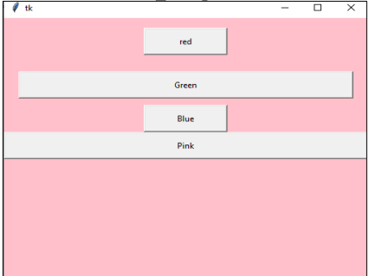
The pack() method can take another option ‘side’ which is used to place the widgets side by side. „side‟ can take the values LEFT, RIGHT, TOP or BOTTOM. The default value is TOP.

Slide 14
For example,
# align towards left with 10 px and 15 px spaces
b1.pack(side=LEFT, padx=10, pady=15)
# align towards bottom with 10 px and 15 px spaces
b2.pack(side=BOTTOM, padx=10, pady=15)
# align towards right with 0 px space around the widget
b3.pack(side=RIGHT)
# align towards top with 0 px space around the widget
b4.pack()
Output : Arrangement of buttons using pack() method with 'side' option

Slide 15
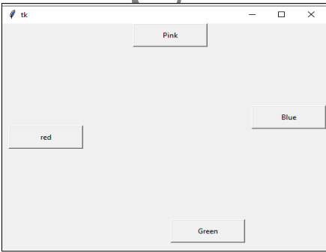

Slide 16
Grid layout manager
Grid layout manager uses the grid() method to arrange the widgets in a two dimensional table that contains rows and columns.
The horizontal arrangement of data is called „row‟ and vertical arrangement is called „column‟. The position of a widget is defined by a row and a column number.
The size of the table is determined by the grid layout manager depending on the widgets size.

Slide 17
Example
# display in 0th row, 0th column with spaces around
bl.grid(row=0, column=0, padx=10, pady=15)
# display in Oth row, 1st column with spaces around
b2.grid(row=0, column=1, padx=10, pady=15
# display in Oth row, 2nd column without spaces around
b3.grid(row=0, column=2)
# display in 1st row, 3rd column without spaces around
b4.grid(row=1, column=3)

Slide 18
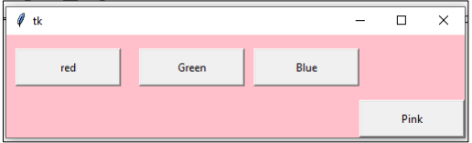

Slide 19
Place layout manager
Place layout manager uses the place() method to arrange the widgets.
The place() method takes x and y coordinates of the widget along with width and height of the window where the widget has to be displayed.
For example:
# display at (20, 30) coordinates in the window 100 pxwidth and 50 pxheight
bl.place(x=20, y=30, width=100, height=50)
b2.place(x=20, y=100, width=100, height=50) # display at (20, 100)
b3.place(x=200, y=100, width=100,height=50)# display at (200, 100)
b4.place(x=200, y=200, width=100, height=50) # display at (200, 100)

Slide 20
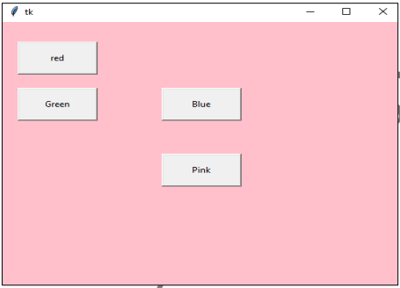

Slide 21
add a scrollbar to a Text widget
It is useful to add scroll bars to the Text widget. A scroll bar is a bar that is
useful to scroll the text either horizontally or vertically. For example, we can create a vertical scroll bar by creating an object to Scroll bar class as:
s = Scrollbar (root, orient=VERTICAL, Command= t.yview)
s=Scrollbar (root, orient=HORIZONTAL, command=t.xview)
'orient' indicates whether it is a vertical scroll bar or horizontal scroll bar.
The„command‟ option specifies to which widget this scroll bar should be connected.
t.yview represents that the scroll bar is connected to „t‟, i.e. Text widget and „yview‟ is for vertical scrolling.(t.xview for horizontal).

Slide 22

A spin box is created as an object of Spinbox class.
s1= Spinbox(f, from_=x to=y, textvariable= val1,width= 15,fg='blue' ,bg='yellow', font=('fontname', size, „fontface‟))
f represents the parent widget.
from_' indicates the starting value and „to‟ indicatesthe ending value in the spin box.
„textvariable' shows the control variable, i.e. Val1 that is created as an object of the IntVar class.

